Slide 1
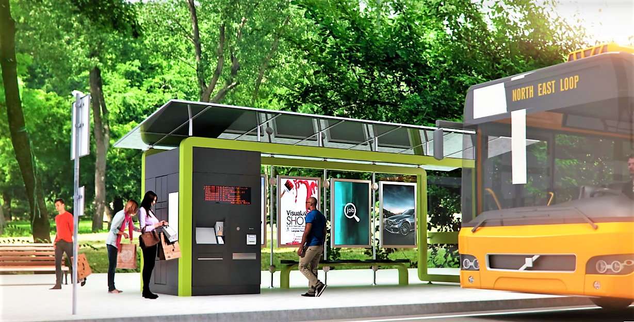
SMART BUS STOP WITH SOLAR ROOFTOP
TEAM NO. 5
SHIVANGI BITHEL
SHIVANI BANSAL

Slide 2
OBJECTIVE
AUTOMATION: To automate conventional processes of man to man ticketing and enquiry for convenience and technological evolution.
USER FRIENDLY INTERFACE: To simplify the enquiry and ticketing processes with user friendly interfaces with smart payment alternatives
COMFORT: To provide commuters with facilities like fans for ventilation, water dispensing machines , open wifi network and charging points for cellular devices .
SECURITY: to prevent unforeseen events like eve-teasing and tampering with smart equipment .
SUSTAINABILITY and FEASIBILITY .

Slide 3
FEATURES AND USE CASE
Provision of Automatic Ticket Vending Machines:
-User friendly Interface
-Multiple languages : Hindi, English and a few regional languages like Punjabi.
-Smart Payment options : which include e-wallets , provision of smart cards and conventional cash.
Interactive feature exclusive for the blind: Through speech recognition the ATVM would be able to detect the aspired source and destination of the blind commuter .
Enquiry Window Mode : To track location of buses, get information about expected arrival and find the shortest route to respective destinations via multiple permutations of available buses.
Provision of basic amenities to commuters like:
-Portable Drinking
-An oscillating fan system
- LED lighting : powered by solar panels on rooftops
-Charging point : powered by solar panels on rooftops
-WiFi access for entertainment and information*
Security Realization:
-Camera : for surveillance.
-Speaker : for announcements of caution for miscreants , public announcements, promotional offers (revenue gen.), etc

Slide 4
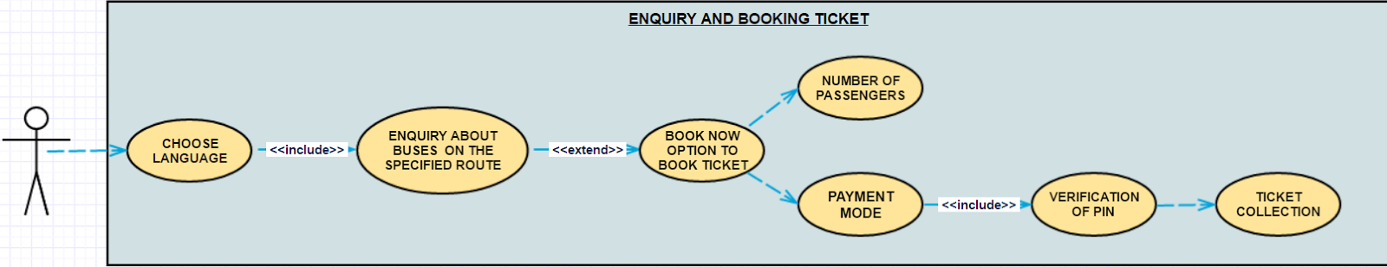
An emergency button: generates heavy alarm on the speaker to invite help from passers-by and notify nearest patrolling police staff for immediate help in emergency .
This exclusive feature double checks security of commuters especially the female commuters at odd hours of the day and at any bus stop irrespective of its unnoticed/neglected location
Sustainability : The requirement for electricity for the mentioned purposes would be made available by Solar panels on the rooftops of our Smart Bus Stops

Slide 5
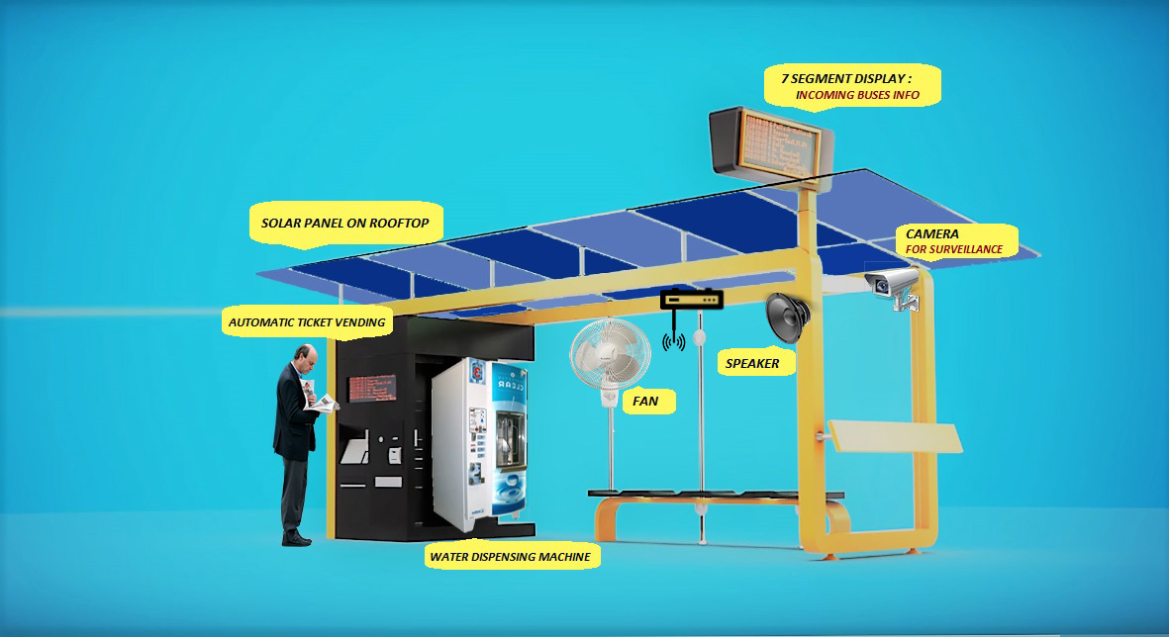
DESIGN

Slide 6
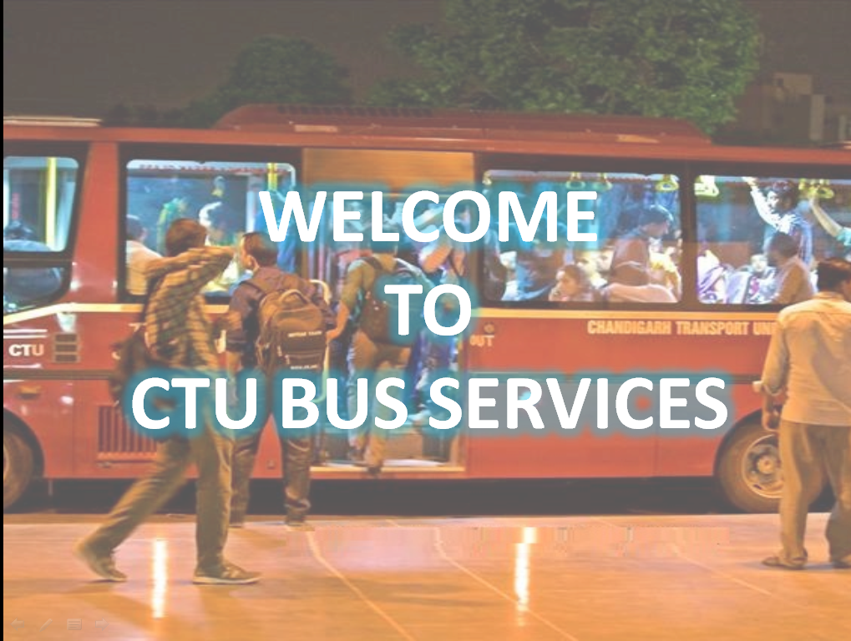
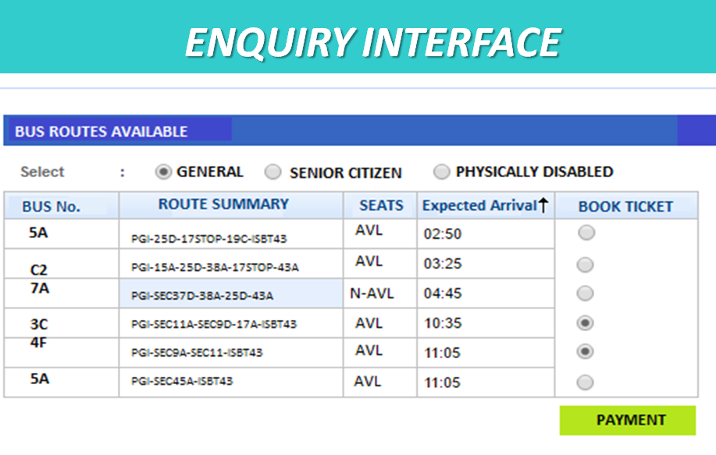
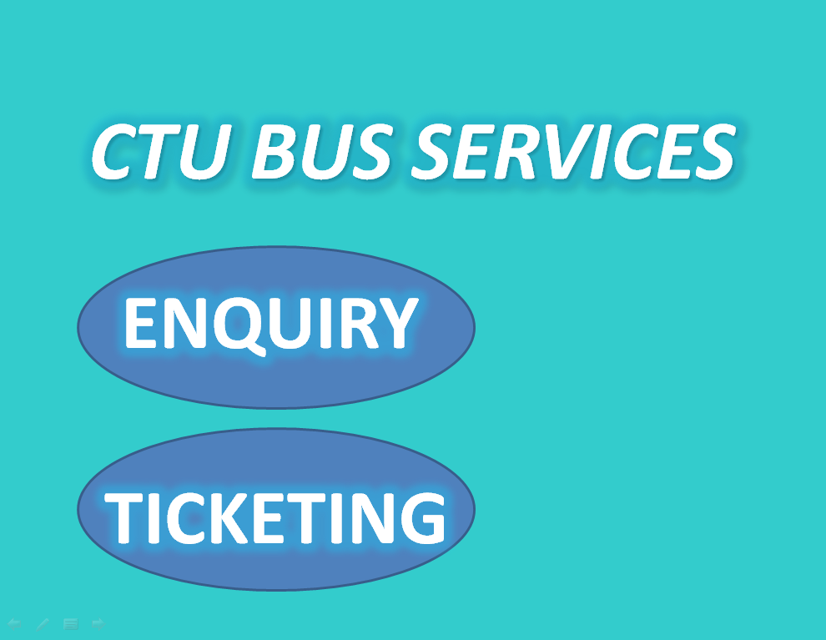
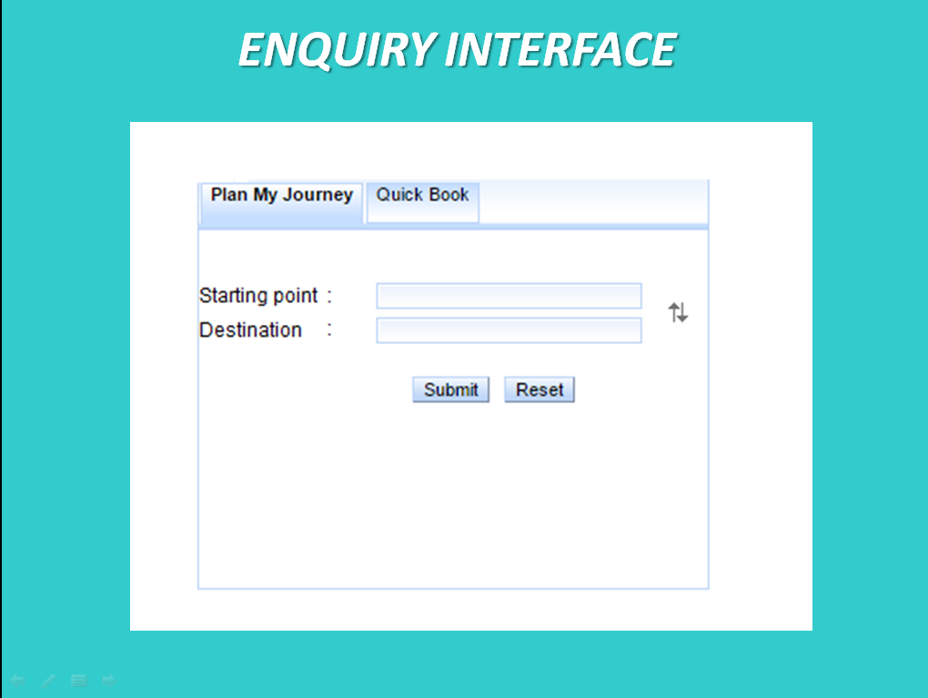
INTERFACE LAYOUT
1
4
2
3

Slide 7
INFRASTURE*
GPS TRACKING DEVICE
An array of GPS Tracking devices with sim slots are available and suitable could be fitted in all buses under the scheme to track buses in Real Time as required here.
WORKING
The GPS tracker continuously tracks the location of the bus and send the updates of Location and Speed to a central server that further processes and relays information to ATVM’s across the city .
Functions:
-Speed of bus : helps in estimation of timing of buses (arrival at a particular stop).
-Location : estimation of timing again as well as a check on overall route of bus.
-Real time tracking of buses
-Rechecking of routes pre decided by authorities .
*Infra concerned with just real time tracking system of buses

Slide 8
CHALLENGES
Setup of solar panels : A complete study has to be performed on the number of selective bus stops where generation of electricity from solar panels is actually feasible and economic . The angle of inclination further of solar panels for maximum solar irradiation is another concern.
Driver’s Reaction : Some drivers may get offended due to legal interference by tracking their routes all the time. Now, they wont be able to modify the routes according to their own convenience.
Initial installation of solar panels, GPS devices, ATVM is pretty expensive .

Slide 9
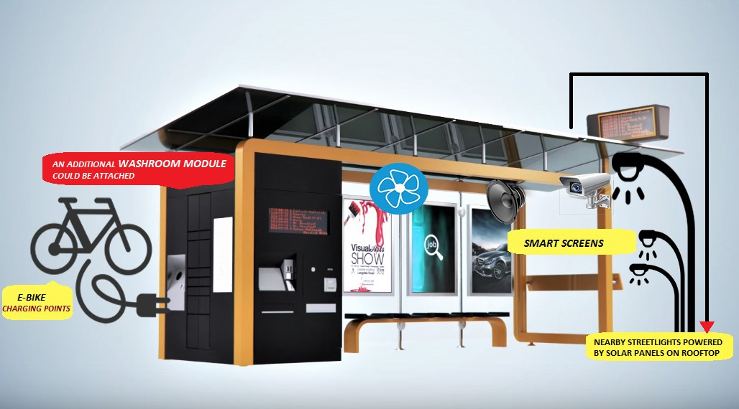
OUTCOMES
Increased revenue to the Road Trans. Corp. with more people switching to this efficient system .
Realization of Smart City ideas balancing feasibility and sustainability .
Security irrespective of the ignored locations of bus stops via cctv surveillance and availability of emergency services.
The future prospects for the model if implemented look somewhat like ….
The future Smart Bus Stop

Slide 10
PLAN FOR NEXT 3 MONTHS
Consult experts from multiple disciplines to supervise their respective departmental work related to the model.
For eg. An architect to finalize the layout of Smart Bus Stop, a Civil Engineer for construction purposes, Electronics and comm. Engineers for setting up of networking facilities between GPS trackers and ATVM and finally IT engineers to implement the interface .
BUDGET PLANNING and Invitation of tenders .
FEASIBILITY CHECK FOR SOLAR PANEL INSTALLATION :
-accessing site conditions for installing solar panels to ensure maximum solar irradiation .
-minor amendments in vicinity to create a proper environment for solar energy capture.
GPS tracking device Setup and Installation
Implementation of connectivity to track buses in Real time through a central server and display of info on ATVM.

Slide 11
THANK YOU REGARDS TEAM NO. 5 SHIVANGI BITHEL (TEAM LEADER) UE158101 SHIVANI BANSAL UE158102

